Slide 1

Python
MatplotLib

Slide 2

MatplotLib
Matplotlib is one of the most popular Python packages used for data visualization.
Cross-platform library for making 2D plots from data in arrays.
Provides an object-oriented API that helps in embedding plots in Applications using Python GUI toolkits such as PyQt, WxPythonotTkinter.
Allows visual access to huge amounts of data in digestible visual
www.skillslash.com

Slide 3
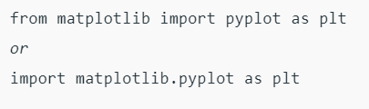
Import matplotlib
www.skillslash.com

Slide 4
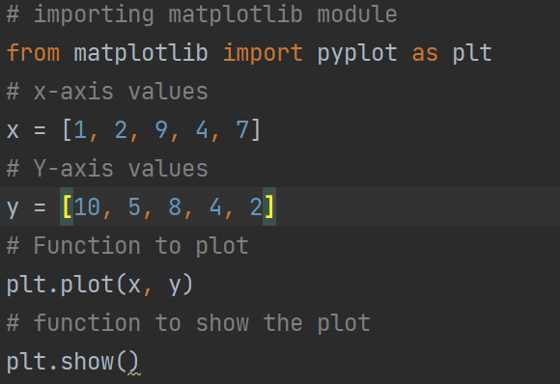
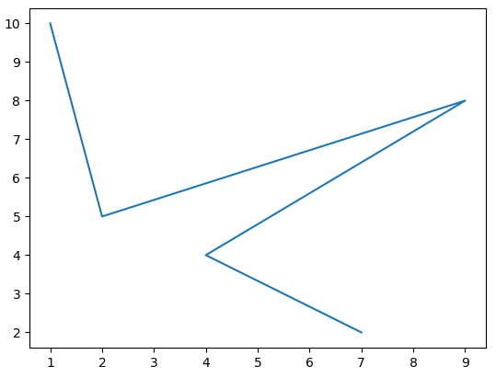
Line plots

Slide 5
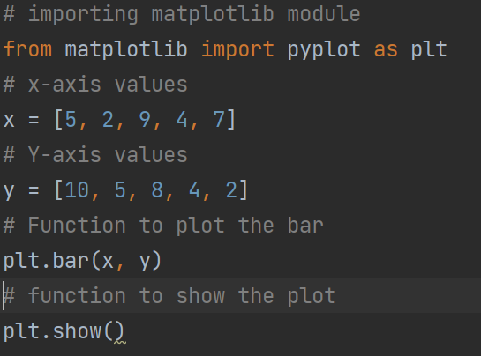
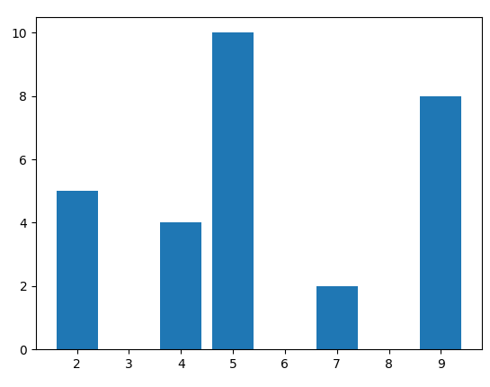
Bar Plots

Slide 6
Histogram and Bar plot difference
A bar graph is the graphical representation of categorical data using rectangular bars where the length of each bar is proportional to the value they represent.
A histogram is the graphical representation of data where data is grouped into continuous number ranges and each range corresponds to a vertical bar.

Slide 7
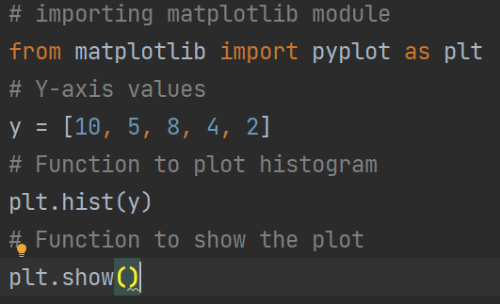
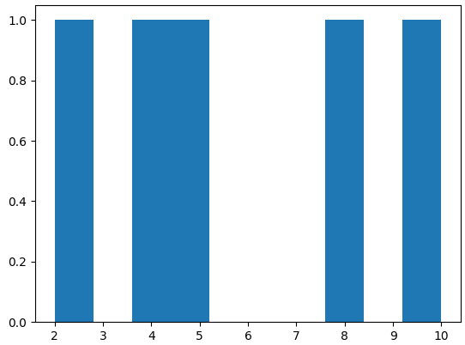
Histogram Plots

Slide 8
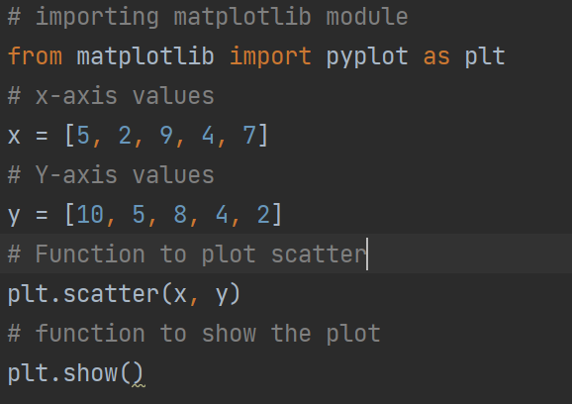
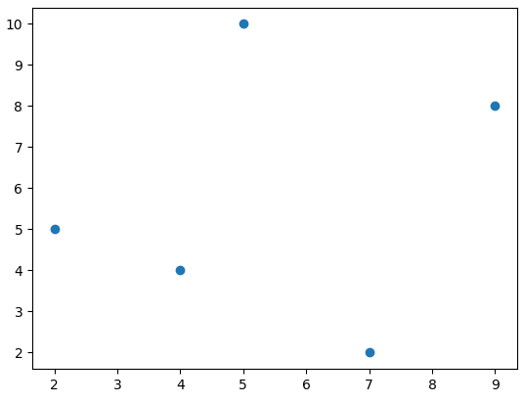
Scatter Plots

Slide 9
Figures and Axes
The matplotlib.figure module contains the Figure class.
It is a top-level container for all plot elements.
The Figure object is instantiated by calling the figure() function from the pyplot module −
fig = plt.figure()
Axes object is the region of the image with the data space.
A given figure can contain many Axes, but a given Axes object can only be in one Figure.
The Axes contains two (or three in the case of 3D) Axis objects.

Slide 10
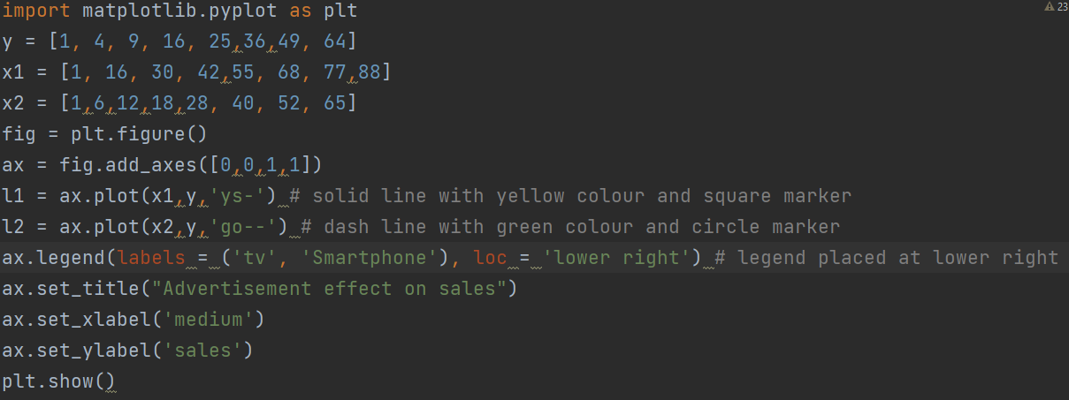

Slide 11
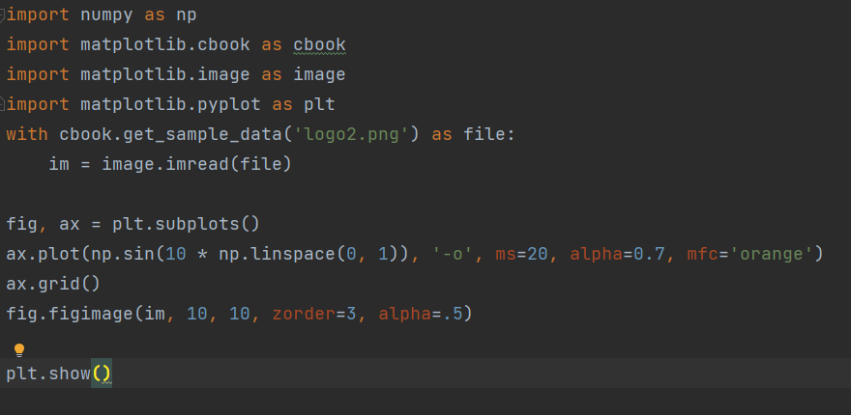
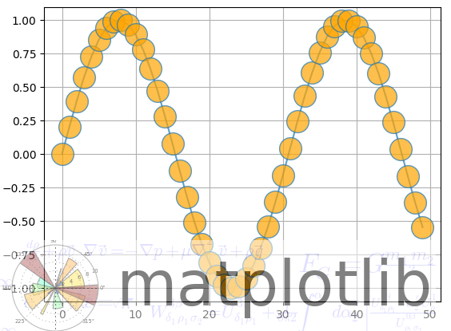
WaterMark

Slide 12
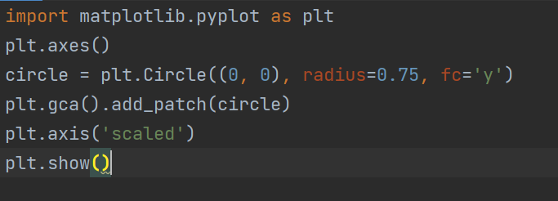
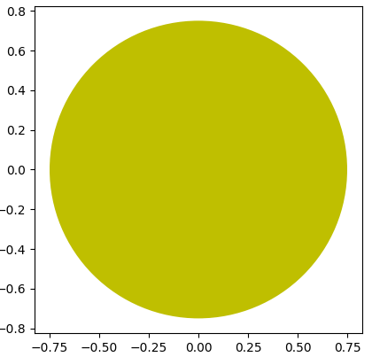
Shapes

Slide 13
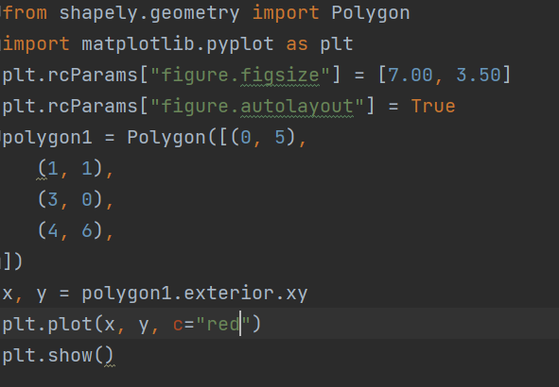
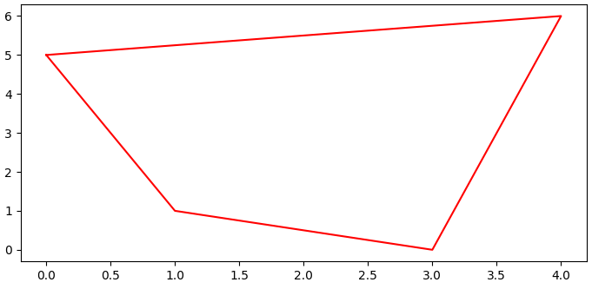
Polygon and Arrows

Slide 14
Polygon and Arrows

Slide 15
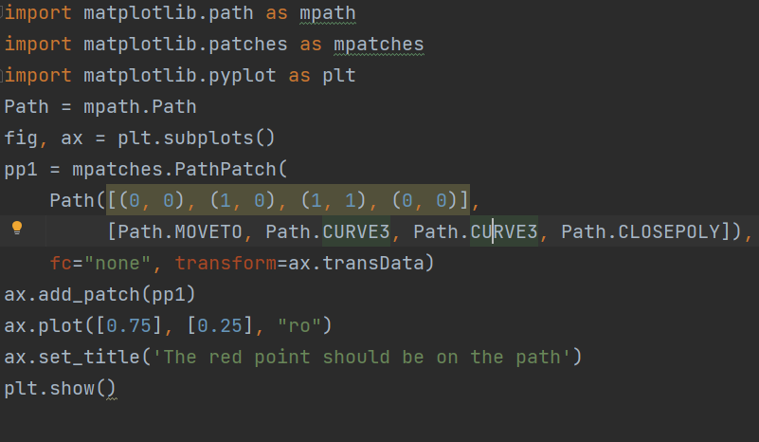
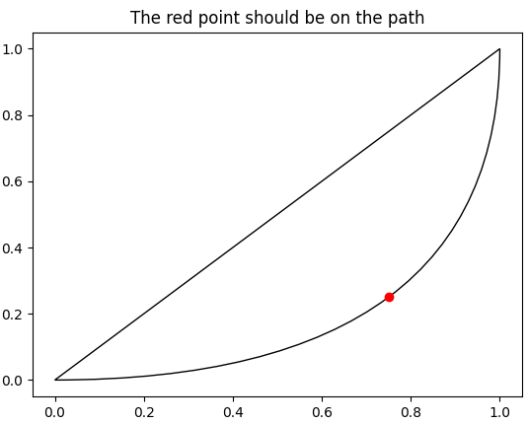
Beizer Curves

Slide 16
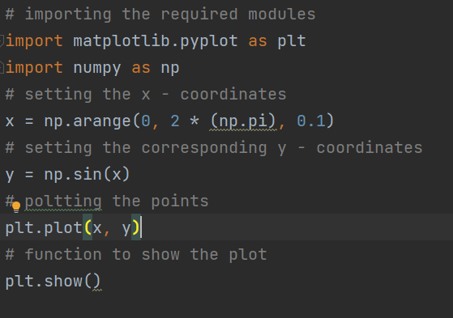
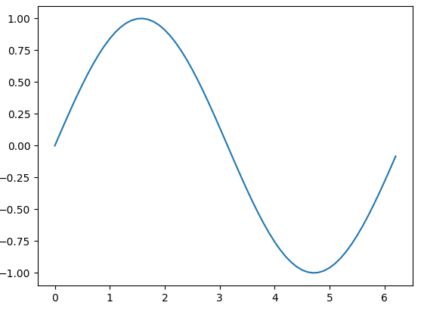
Curves

Slide 17
Annotations
The annotate() function in pyplot module of matplotlib library is used to annotate the point xy with text s.
Syntax: angle_spectrum(x, Fs=2, Fc=0, window=mlab.window_hanning, pad_to=None, sides=’default’, **kwargs)
Parameters: This method accept the following parameters that are described below:
s: This parameter is the text of the annotation.
xy: This parameter is the point (x, y) to annotate.
xytext: This parameter is an optional parameter. It is The position (x, y) to place the text at.
xycoords: This parameter is also an optional parameter and contains the string value.
textcoords: This parameter contains the string value.Coordinate system that xytext is given, which may be different than the coordinate system used for xy
arrowprops : This parameter is also an optional parameter and contains dict type.Its default value is None.
annotation_clip : This parameter is also an optional parameter and contains boolean value.Its default value is None which behaves as True.
Returns: This method returns the annotation.

Slide 18
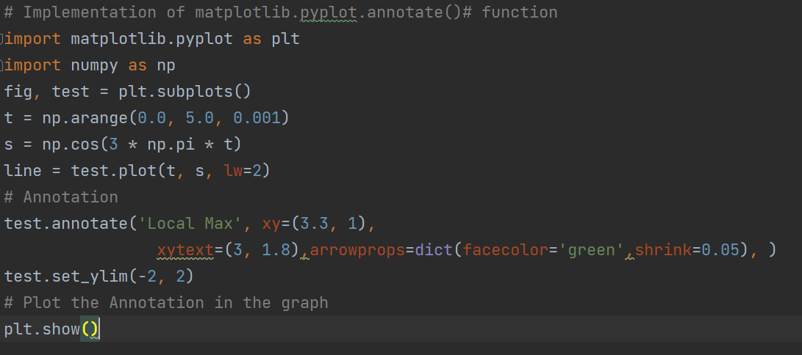

Slide 19
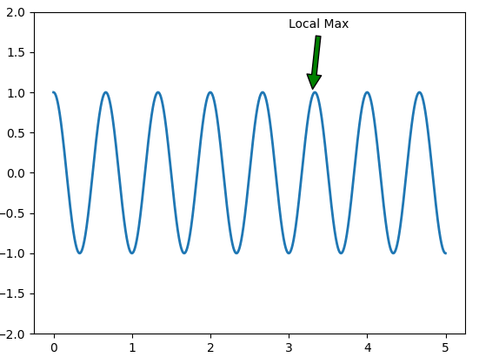

Slide 20
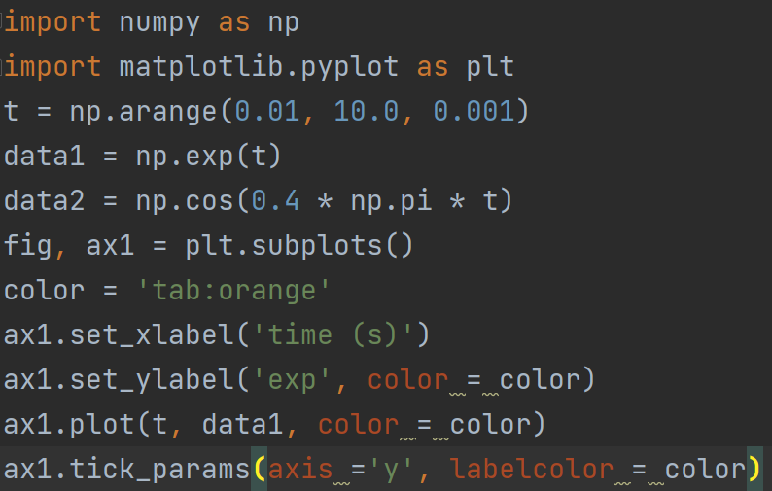
Twin Axis
Notes:
import numpy as np import matplotlib.pyplot as plt t = np.arange(0.01, 10.0, 0.001) data1 = np.exp(t) data2 = np.cos(0.4 * np.pi * t) fig, ax1 = plt.subplots() color = 'tab:orange' ax1.set_xlabel('time (s)') ax1.set_ylabel('exp', color = color) ax1.plot(t, data1, color = color) ax1.tick_params(axis ='y', labelcolor = color) ax2 = ax1.twinx() color = 'tab:cyan' ax2.set_ylabel('cos', color = color) ax2.plot(t, data2, color = color) ax2.tick_params(axis ='y', labelcolor = color) fig.suptitle('matplotlib.axes.Axes.twinx()function Example\n\n', fontweight ="bold") plt.show()

Slide 21
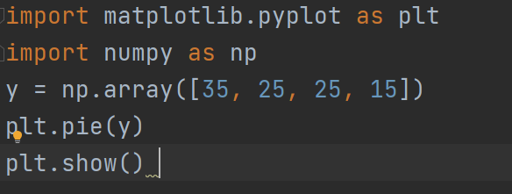
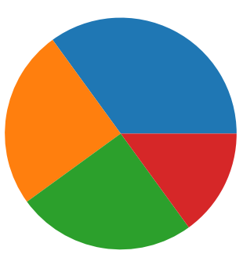
Pie Charts

Slide 22
Autocorrelation
Autocorrelation plots are a commonly used tool for checking randomness in a data set. This randomness is ascertained by computing autocorrelations for data values at varying time lags.
It measures a set of current values against a set of past values and finds whether they correlate.
It is the correlation of one-time series data to another time series data which has a time lag.
It varies from +1 to -1.
An autocorrelation of +1 indicates that if time series one increases in value the time series 2 also increases in proportion to the change in time series 1.
An autocorrelation of -1 indicates that if time series one increases in value the time series 2 decreases in proportion to the change in time series 1.

Slide 23
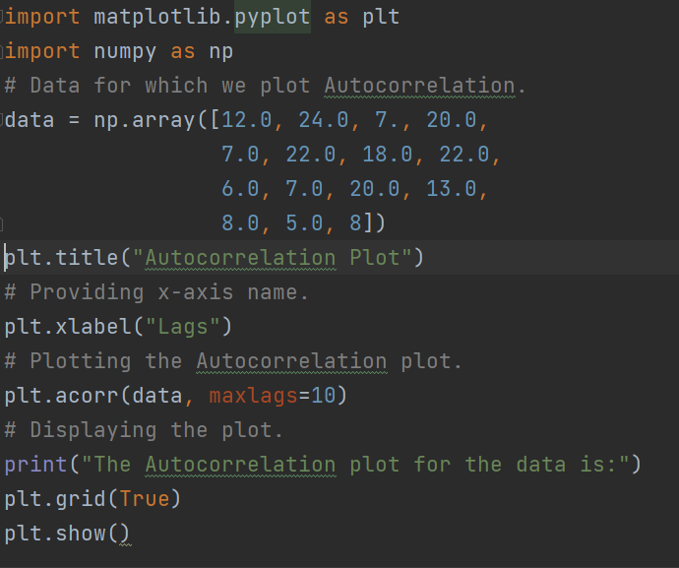
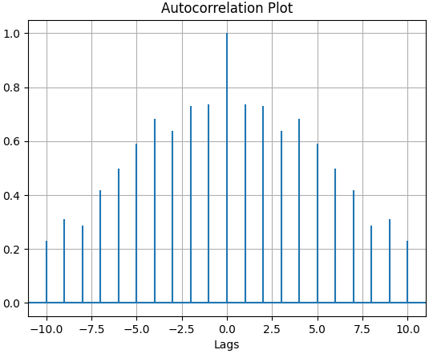

Slide 24
THANK YOU
www.skillslash.com

